Slide 1


Introduction to Cybersecurity
ILIA STATE UNIVERSITY
Paata Gogishvili
Doctor of Informatics
Associate Professor
School of Technology
March 20, 2023
Faculty of Business, Technology and Education

Slide 2
Lecture Topics
Information Collection
Research of Weaknesses
Footprinting
ILIA STATE UNIVERSITY

Slide 3
Information Collection Importance
Information collection is a critical aspect of cybersecurity and plays a crucial role in threat intelligence. Cybersecurity threats can come from various sources, including internal and external attackers, malicious insiders, and even unintentional mistakes by employees. To effectively protect against these threats, cybersecurity professionals must gather and analyze information to understand the current threat landscape and take proactive measures to prevent attacks.
This activity involves gathering data and information about the target entity, such as a company, organization, or individual. The data can be collected from publicly available sources such as social media, news articles, job postings, and company websites. Private data may also be collected through targeted attacks such as phishing, social engineering, or hacking.
ILIA STATE UNIVERSITY

Slide 4
Types of Information Collection
There are several types of information collection in cybersecurity, and they can be broadly categorized into two main categories: passive and active.
Passive information gathering: Here, you acquire as much information as you can about the target without establishing any contact between yourself and the target. The chances of getting discovered here are extremely low, since you will be mostly leveraging information that is publicly available. There are numerous tools that can help you do this
Active information gathering: Here, you acquire as much information as possible, yet establishing contact with the target. The chances of getting discovered here are much higher than when conducting passive information gathering. While using tools here, you need to be careful not to cause too much noise on the network in order to avoid detection by Intrusion Detection Systems and SIEMs
ILIA STATE UNIVERSITY

Slide 5
Passive Information Gathering
Network Traffic Analysis: This involves analyzing network traffic to identify potential threats. This can be done by monitoring network traffic using tools such as Intrusion Detection Systems (IDS) or Intrusion Prevention Systems (IPS).
Open Source Intelligence (OSINT): This involves collecting information from publicly available sources such as social media, blogs, and news articles. OSINT can provide valuable insights into potential threats and help identify trends in the threat landscape.
System and application logging: This involves collecting data from system and application logs. System and application logs can provide valuable information about potential security breaches or attacks.
ILIA STATE UNIVERSITY

Slide 6
Passive Information Gathering Tools
Search Engines, Automatic Alerts, Forums, Internet Archive
Maltego
whois
Intercepting Proxies
Web Spiders
Netcraft
Pastebin.com
PassiveTotal: PassiveTotal is a paid tool that allows you to passively monitor and investigate malicious activity across various data sources, including DNS, IP, and WHOIS.
Shodan: Shodan is a search engine for internet-connected devices. It allows you to discover the types of devices and systems connected to the internet, along with information about their configuration.
ILIA STATE UNIVERSITY

Slide 7
Why Ethical Hacking?
For self-defense, it is necessary to have proper tools and know how to use these tools.
After obtaining permission, an ethical hacker conducts a system defense test to discover its weaknesses.
Obviously, hacking can be used to commit malicious acts, however, we should know that such actions are punishable by law. Therefore, hacking should be carried out only for the purpose of checking the defense capability of the system and with the presence of proper permission!
You can't become a cyber security expert without knowing ethical hacking!
ILIA STATE UNIVERSITY

Slide 8




Types of Hackers
ILIA STATE UNIVERSITY
Black Hat Hackers
White Hat Hackers
Grey Hat Hackers

Slide 9


Unauthorized hacking is a punishable act!
ILIA STATE UNIVERSITY

Slide 10
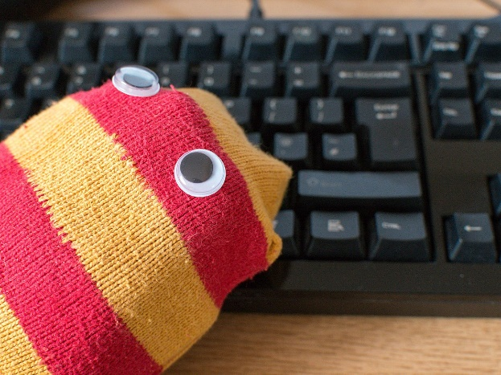
Sockpuppet Account
An online identity created, and used, for purposes of deception. A sockpuppet purports to be an independent party that supports, approves of, or agrees with some agent (a person, organization, agency, or state), but is in fact created and controlled by that agent, and has no independent existence.
Facebook trolls can be considered as a kind of puppet. They are mainly created for political purposes and are tasked with praising their patrons and criticizing their opponents.
ILIA STATE UNIVERSITY

Slide 11
Sockpuppet Requirements
These items are used to better ensure your privacy and make it more difficult for organizations, other sock puppeteers, or sock puppet hunters to connect your sock puppet to you. You can always choose to remove these items or add others.
A separate, dedicated computer
A set of virtual machines (VMs)
A virtual private network (VPN)
A separate email address for your sock puppet account
A profile picture
A separate “burner” phone
A blog and a social media accounts
ILIA STATE UNIVERSITY

Slide 12
Sockpuppet Requirements
Choose a sock puppet style. There are two options 1. fake identity and 2. fake idea/avatar.
The first option entails creating a person with a name and an entire identity around them in order to make the account feel authentic. In the worst case, if your cover is blown, you will have to delete everything and start over. This option is the most effective way to operate.
Option 2 is creating an avatar that’s focused around an idea rather than a unique identity. The second option is probably the easiest approach for most.
https://this-person-does-not-exist.com
ILIA STATE UNIVERSITY

Slide 13
Check Your Account
Constantly collect OSINT on your sock puppet and reverse engineer your own creation, have a friend or colleague take a look at it and see if they can find a way in.
And don’t forget to check the big giveaways like your image data and domain registration.
Google search for name and photo. Travel to that region, street.
ILIA STATE UNIVERSITY

Slide 14
Stay Active But Grow Authentically
Once your tools are in place and you’ve ensured your identity is untraceable, you can let your sock out in public. It’s time to create your social media profiles and start posting unique content and status updates, as well as interacting with people in your target group niche.
But in order to build trust and maintain credibility, it’s important to start slow.
ILIA STATE UNIVERSITY

Slide 15
Active Information Gathering
Vulnerability Scanning: This involves using automated tools to scan networks and systems for vulnerabilities. Vulnerability scanning can help identify weaknesses that could be exploited by attackers.
Penetration Testing: This involves simulating an attack on a network or system to identify vulnerabilities and weaknesses. Penetration testing can help identify potential security gaps before they can be exploited by attackers.
Social Engineering: This involves using tactics such as phishing emails or phone calls to trick users into providing sensitive information. Social engineering can be used to gain access to systems or networks that may be otherwise difficult to penetrate.
ILIA STATE UNIVERSITY

Slide 16
Active Information Gathering
Search Engines: Search engines like Google, Bing, and DuckDuckGo are the most commonly used tools for active information gathering. They allow you to search for information using specific keywords, phrases, or questions.
Social Media: Social media platforms like Twitter, Facebook, LinkedIn, and Instagram can also be useful for gathering information. You can search for relevant posts, hashtags, or people and follow them to stay updated.
Online Forums and Communities: Online forums and communities like Reddit, Quora, and Stack Overflow are great places to find answers to specific questions and gather information on particular topics.
ILIA STATE UNIVERSITY

Slide 17
Active Information Gathering
Web Scrapers: Web scrapers like Scrapy, Beautiful Soup, and Puppeteer allow you to extract data from websites automatically. You can use them to scrape data from websites that don't offer an API.
OSINT Tools: Open Source Intelligence (OSINT) tools like Maltego, SpiderFoot, and Shodan can help you gather information from public sources like government databases, social media, and other online sources.
Reconnaissance Tools: Reconnaissance tools like Nmap, Netcraft, and Whois can help you identify and gather information about network infrastructure, domains, IP addresses, and other online assets.
ILIA STATE UNIVERSITY

Slide 18
Footprinting
Footprinting is the process of gathering information about the target's digital footprint, such as its IP addresses, domain names, and other identifying information. This information can be used to identify potential attack vectors and weak points in the target's digital defenses.
Information gathering can done for many purposes, for example, risk mitigation, vulnerability estimation, … however, footprintng is the prelude for cyber attack.
ILIA STATE UNIVERSITY

